Slide 1
Module-2 Line Encoding

Slide 2
DIGITAL-TO-DIGITAL CONVERSION
In this section, we see how we can represent digital data by using digital signals. The conversion involves three techniques: line coding, block coding, and scrambling. Line coding is always needed; block coding and scrambling may or may not be needed.
Topics discussed in this section:
Line Coding
Line Coding Schemes

Slide 3
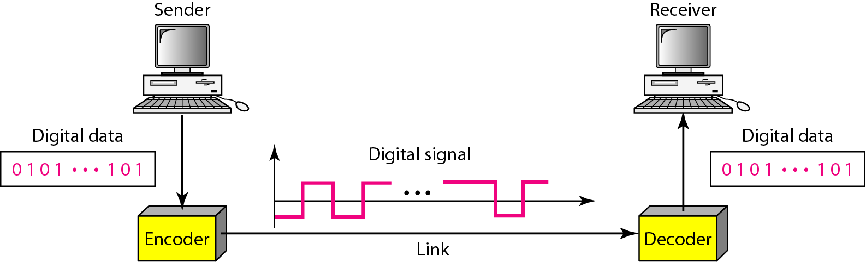
LINE CODING
Line coding is the process of converting digital data to digital signals. We assume that data, in the form of text, numbers, graphical images, audio, or video, are stored in computer memory as sequences of bits.
Line coding and decoding

Slide 4
LINE CODING . . .

Slide 5
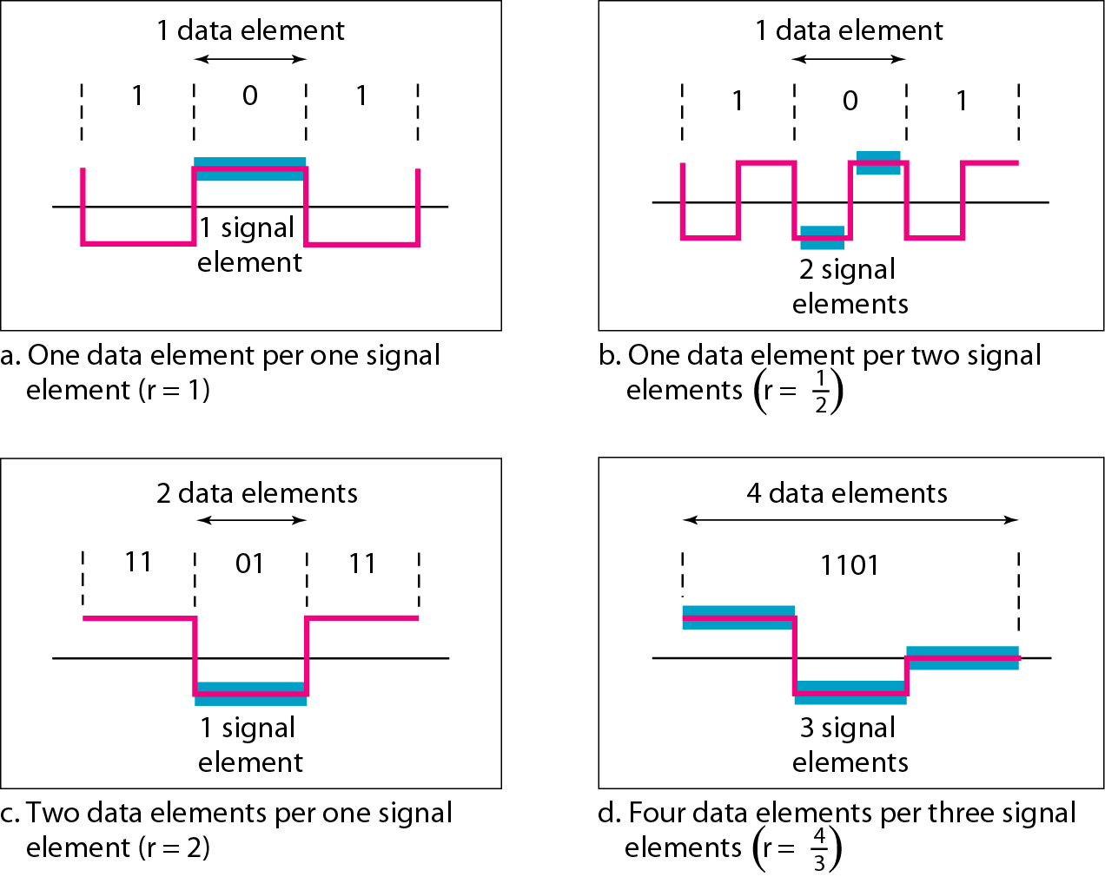
LINE CODING SCHEMES CHARACTERISTICS
Signal Element Versus Data Element :
Goal is to send data elements. Data element is the smallest entity that can represent a piece of information: this is the bit.
A signal element carries data elements. A signal element is the shortest unit (time wise) of a digital signal.
Data elements are what we need to send; signal elements are what we can send. Data elements are being carried; signal elements are the carriers.
We define a ratio r which is the number of data elements carried
by each signal element.
Signal element versus
data element

Slide 9
Baseline Wandering : In decoding a digital signal, the receiver calculates a running average of the received signal power. This average is called the baseline. The incoming signal power is evaluated against this baseline to determine the value of the data element. A long string of Os or 1 s can cause a drift in the baseline (baseline wandering) and make it difficult for the receiver to decode correctly. A good line coding scheme needs to prevent baseline wandering.
DC Components : When the voltage level in a digital signal is constant for a while, the spectrum creates very low frequencies . These frequencies around zero, called DC (direct-current) components, present problems for a system that cannot pass low frequencies or a system that uses electrical coupling (via a transformer). For example, a telephone line cannot pass frequencies below 200 Hz. Also a long-distance link may use one or more transformers to isolate different parts of the line electrically. For these systems, we need a scheme with no DC component.
Self-synchronization : To correctly interpret the signals received from the sender, the receiver's bit intervals must correspond exactly to the sender's bit intervals. If the receiver clock is faster or slower, the bit intervals are not matched and the receiver might misinterpret the signals.

Slide 10
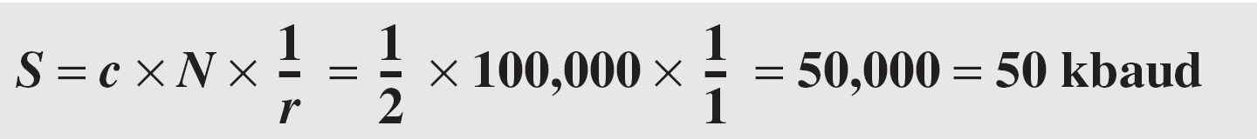
Solution
A signal is carrying data in which one data element is encoded as one signal element ( r = 1). If the bit rate is 100 kbps, what is the average value of the baud rate if c is between 0 and 1?
Solution
We assume that the average value of c is 1/2 . The baud rate is then
Notes:
Data rate / bit rate signal rate / baud rate

Slide 11
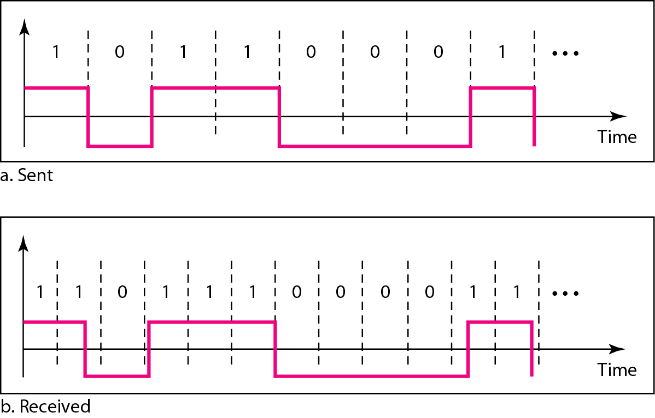
Effect of lack of Synchronisation
A self-synchronizing digital signal includes timing information in the data being transmitted. This can be achieved if there are transitions in the signal that alert the receiver to the beginning, middle, or end of the pulse. If the receiver' s clock is out of synchronization, these points can reset the clock.

Slide 12
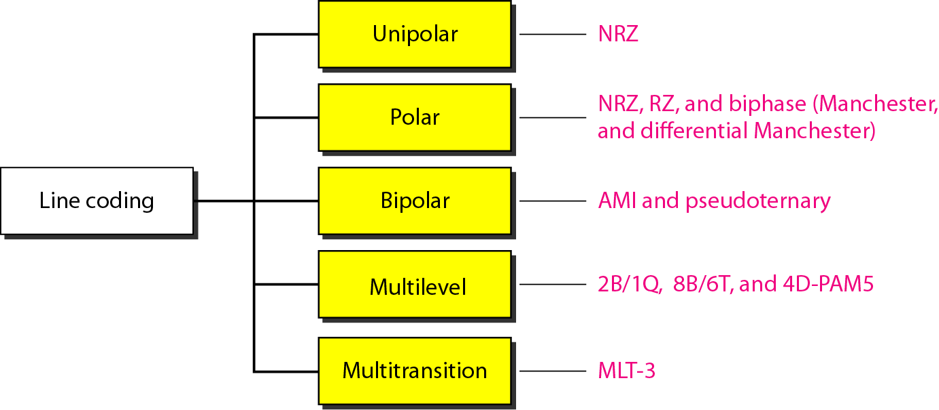
LINE CODING SCHEMES

Slide 13
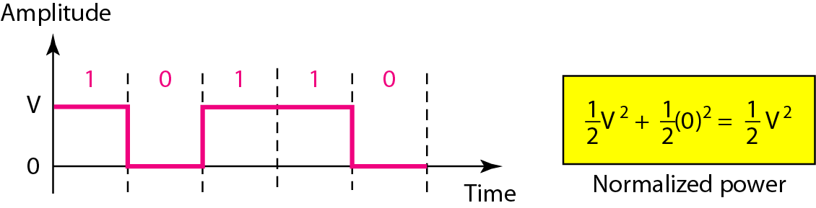
UNIPOLAR
All signal levels are on one side of the time axis - either above or below.
NRZ - Non Return to Zero scheme is an example of this code. The signal level does not return to zero during a symbol transmission.
Scheme is prone to baseline wandering and DC components. It has no synchronization or any error detection. It is simple but costly in power consumption.

Slide 14
POLAR - NZR
The voltages are on both sides of the time axis.
Polar NRZ scheme can be implemented with two voltages. E.g. +V for 1 and -V for 0.
There are two versions:
NZR - Level (NRZ-L) - positive voltage for one symbol and negative for the other
NRZ - Inversion (NRZ-I) - the change or lack of change in polarity determines the value of a symbol. E.g. a “1” symbol inverts the polarity a “0” does not.

Slide 15
POLAR NZR – L and NRZ – I SCHEMES

Slide 16

Note
In NRZ-L the level of the voltage determine the value of the bit.
In NRZ-I the inversion or the lack of inversion determines the value of the bit.
NRZ-L and NRZ-I both have an average signal rate of N/2 Bd.
NRZ-L and NRZ-I both have a DC component problem and baseline wandering, it is worse for NRZ-L.
Both have no self synchronization &no error detection. Both are relatively simple to implement.

Slide 17
POLAR RZ SCHEME
The Return to Zero (RZ) scheme uses three voltage values. +, 0, -.
Each symbol has a transition in the middle. Either from high to zero or from low to zero.
This scheme has more signal transitions (two per symbol) and therefore requires a wider bandwidth.
No DC components or baseline wandering.
Self synchronization - transition indicates symbol value.
More complex as it uses three voltage level. It has no error detection capability.

Slide 18
POLAR RZ SCHEME

Slide 19
POLAR – BIPHASE : MANCHESTER AND DIFFERENTIAL MANCHESTER
Manchester coding consists of combining the NRZ-L and RZ schemes.
Every symbol has a level transition in the middle: from high to low or low to high. Uses only two voltage levels.
Differential Manchester coding consists of combining the NRZ-I and RZ schemes.
Every symbol has a level transition in the middle. But the level at the beginning of the symbol is determined by the symbol value. One symbol causes a level change the other does not.

Slide 20
POLAR – BIPHASE : MANCHESTER AND DIFFERENTIAL MANCHESTER
SCHEMES

Slide 21
Note
In Manchester and differential Manchester encoding, the transition at the middle of the bit is used for synchronization.
The minimum bandwidth of Manchester and differential Manchester is 2 times that of NRZ. The is no DC component and no baseline wandering. None of these codes has error detection.

Slide 22
POLAR – AMI AND PSEUDOTERNARY
Code uses 3 voltage levels: - +, 0, -, to represent the symbols (note not transitions to zero as in RZ).
Voltage level for one symbol is at “0” and the other alternates between + & -.
Bipolar Alternate Mark Inversion (AMI) - the “0” symbol is represented by zero voltage and the “1” symbol alternates between +V and -V.
Pseudoternary is the reverse of AMI.

Slide 23
POLAR – AMI AND PSEUDOTERNARY

